Slide 1
Peer Pressure

Slide 2
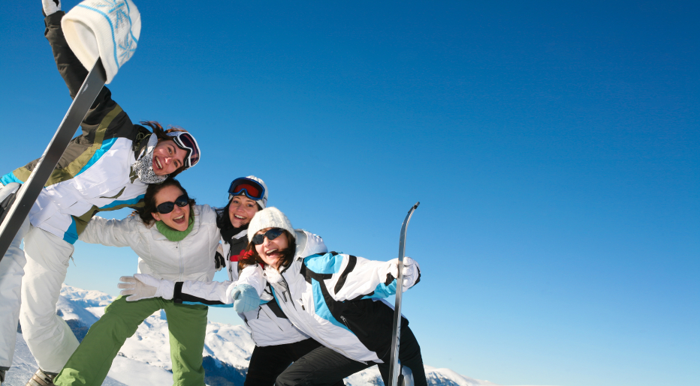
Friendship make up a valuable, positive element in our lives. The three components of good friendships are:
Belonging & Acceptance
Share Feelings & Experiences
Sense of Personal Worth

Slide 3
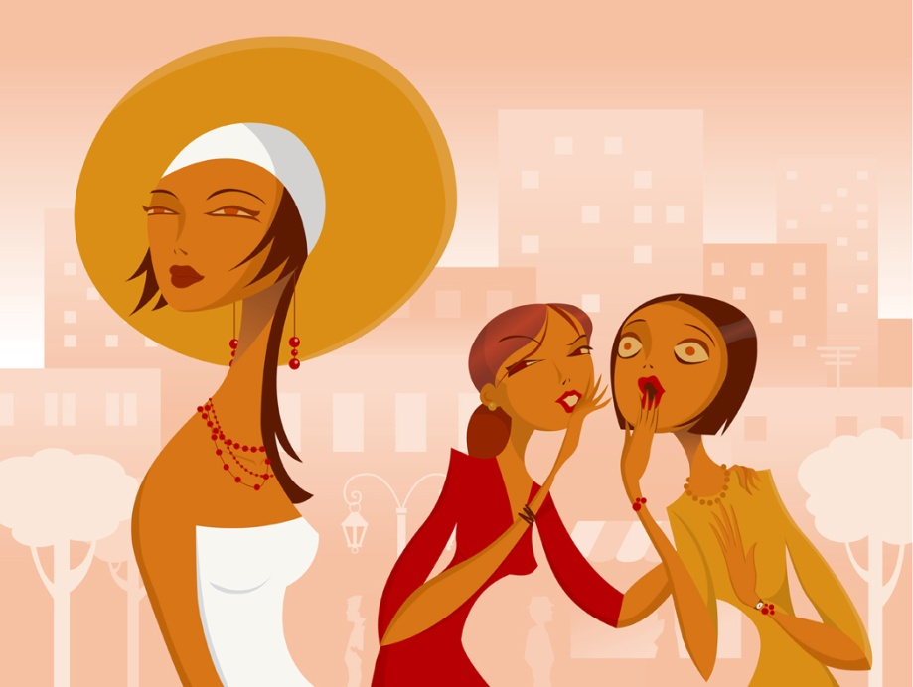
Many teens confuse Friendship with peer pressure, or going along with the crowd.

Slide 4
What are three ways of recognizing Peer Pressure?
Going along with the crowd
Having group make decisions
Believing everybody does it

Slide 5
What is NEGATIVE peer pressure?
Doing things you really don’t want to do
Doing something only to be part of the crowd
Loss of self control
Personal Conflict (right vs. wrong)
Judged by actions of group

Slide 6
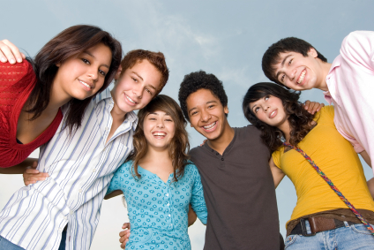
Can peer pressure be POSITIVE?
YES!
Pressure into doing GOOD things
Influences you to stick to your values and goals
The key is listening to your feelings

Slide 7
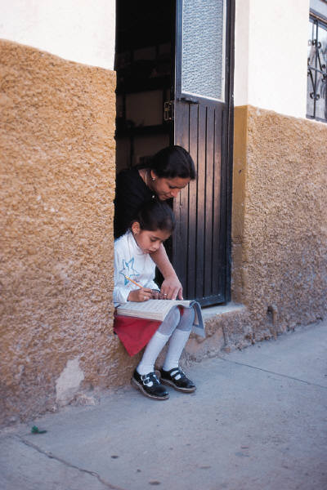
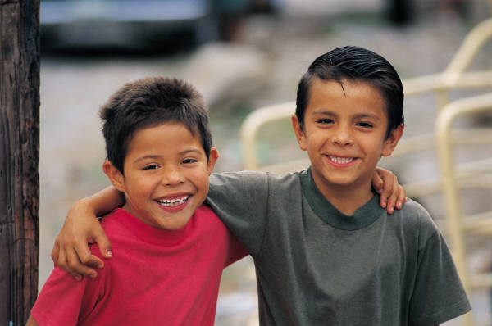
What are some ways that you can deal with Peer Pressure?
Make your own decisions!
Know who you are and who you want to be!
Set realistic positive goals!
Weigh the consequences of your actions!
Say no!

Slide 8
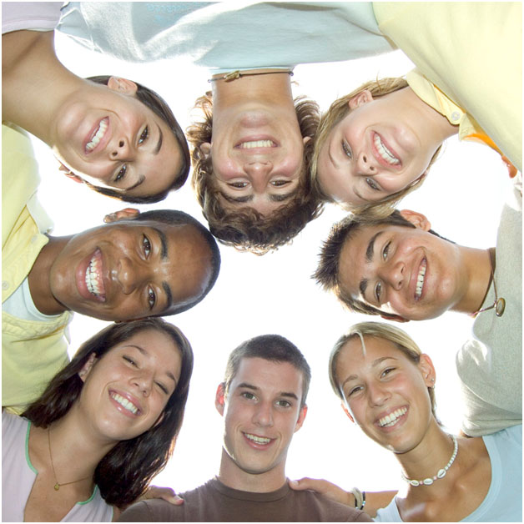
Basic Guidelines for Saying “No” (Refusal Skills)
Stay calm
Make eye contact
Be assertive
Repeat if necessary
(“Broken Record” Technique)
Walk away

Slide 9
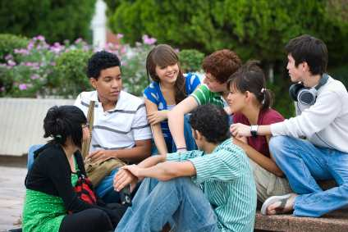
Other Ways to “Save Face”
Broken record technique
Give reasons or excuses
Find a friend who feels the same way you do, or recruit an ally.
Avoid the situation
Change the subject
Take a stand
Take the pledge
It’s the Law

Slide 10
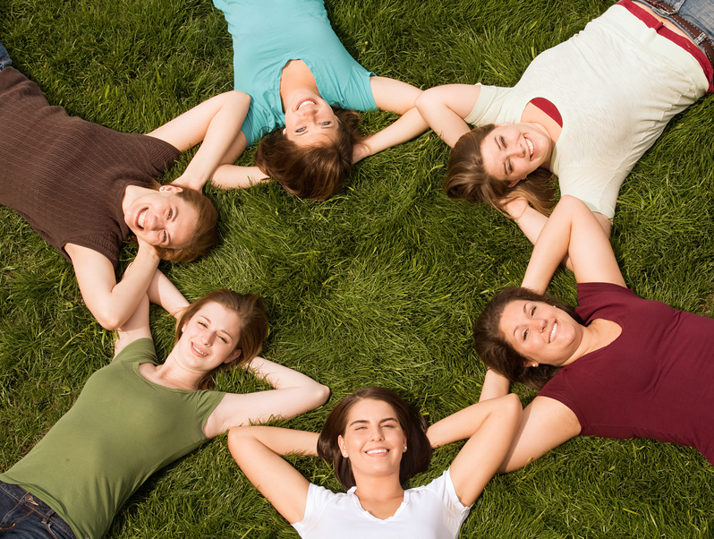
People who feel good about themselves don’t fear group rejection.

Slide 11
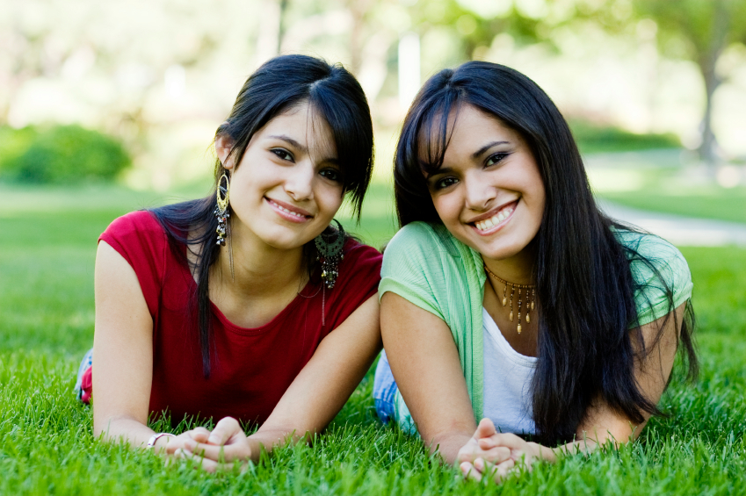
Looking Logically at Peer Group Rejection.
Threat designed to take away your self control
Does not mean rejection by everyone

Slide 12
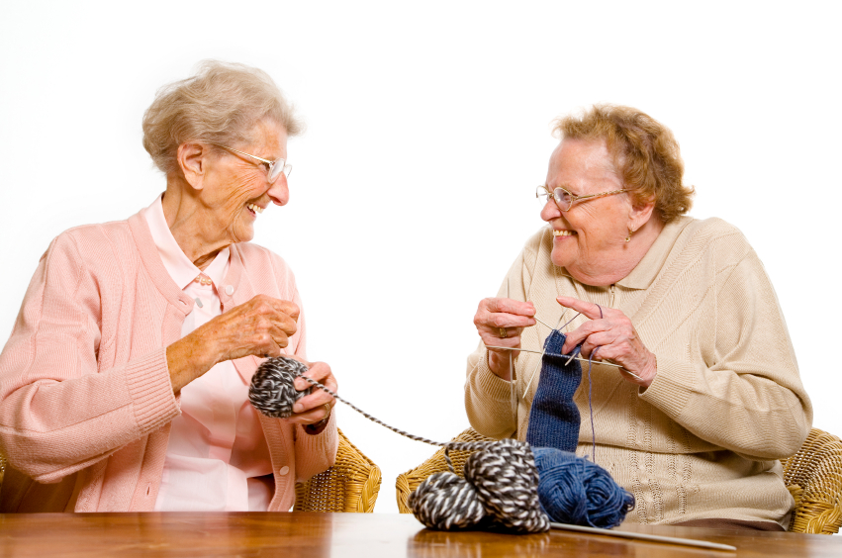
If you feel good about your self, others will notice.

