Slide 1
Parts of an EGG

Slide 2
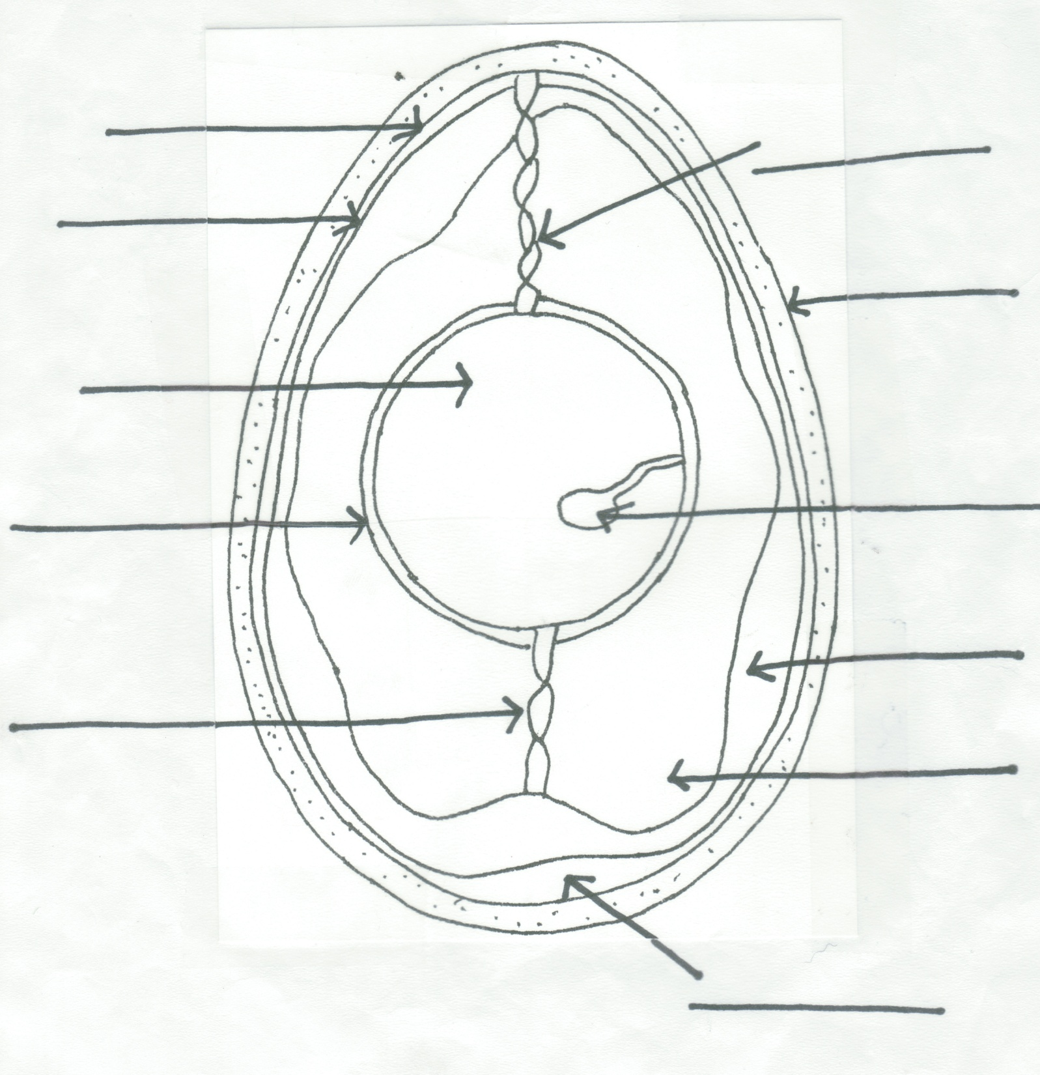
Shell
-made of calcium carbonate
-7,000 pores
-allows transfer of gases through shell

Slide 3
Outer Membrane
-protects egg from bacteria
Shell

Slide 4
Outer Membrane
Inner Membrane
-protects egg from bacteria
-prevents moisture loss
Shell

Slide 5
Outer Membrane
Inner Membrane
Shell
Air Cell
-as egg contents contract, air cell forms
-older the egg, bigger the air cell

Slide 6
Outer Membrane
Inner Membrane
Shell
Thin Albumen
-also known as egg whites
-contains protein for development
Air Cell

Slide 7
Outer Membrane
Inner Membrane
Shell
Thin Albumen
Thick Albumen
-also known as egg whites
-liquid medium for development
Air Cell

Slide 8
Outer Membrane
Chalazae
Inner Membrane
Shell
Thin Albumen
Chalazae
-twisted strands of special proteins
-suspend the yolk in the center of the egg
Thick Albumen
Air Cell

Slide 9
Outer Membrane
chalazae
Inner Membrane
Shell
Vitelline Membrane
-protects the yolk
Thin Albumen
Chalazae
Thick Albumen
Air Cell

Slide 10
Outer Membrane
chalazae
Inner Membrane
Shell
Yolk
-contains all the fat
-source of food for the embryo
Vitelline Membrane
Thin Albumen
Chalazae
Thick Albumen
Air Cell

Slide 11
Outer Membrane
chalazae
Inner Membrane
Shell
Yolk
Germ Spot
-where the genetic information is found
Vitelline Membrane
Thin Albumen
Chalazae
Thick Albumen
Air Cell

